Slide 1
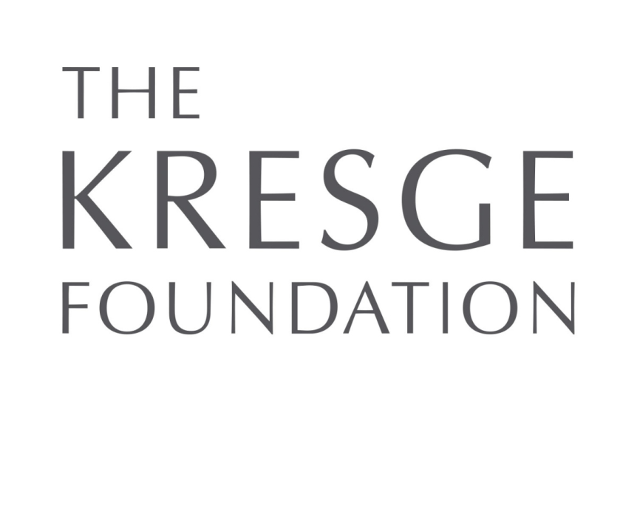
Kresge Community Finance RFP Webinar April 13, 2016
Notes:
Good afternoon or good evening based on where you are in the country.
I would like to open up this webinar by welcoming all of you. We are really excited you are
joining us today to learn more about the Kresge Foundation Initiative Kresge Community Finance.

Slide 2
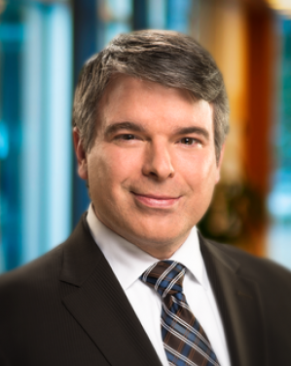
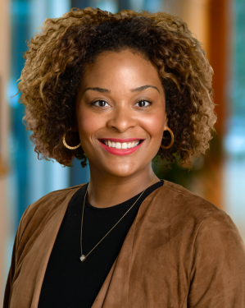
Today’s Presenters
Joe Evans
Portfolio Manager,
Social Investment Practice
Erin Patten
Special Assistant to the President
Executive Office
Notes:
My name is Joe Evans, and I am the portfolio manager for the Kresge Foundation’s Social Investment Practice. I’m managing the foundation’s newly launched RFP, which we are here to talk about today, Kresge Community Finance.

Slide 3
Goals of this webinar
Share background of Kresge and our social investment work
Share background and intent of this funding opportunity
Outline what we are seeking in competitive proposals
Discuss details on how to apply
Answer your questions
Notes:
During this webinar today we will share information
* About Kresge and our social Investment practice
about how this initiative came about
the elements we consider important in making a proposal compelling and competitive
We will talk about the mechanics of applying, how to navigate Kresge’s online system, deadlines, etc.
And finally we have left a lot of time for questions. You will do so by entering your question in the box on the lower right hand side of your screen.
We will have a Frequently Asked Questions. If we don’t get to all of the questions posed today, we will include answers to those in the FAQ’s.
Finally I would like to mention that this webinar is being recorded and will be posted within 24 hours after the webinar, for anyone who might be interested in hearing portions again or for those who may have missed it.

Slide 4
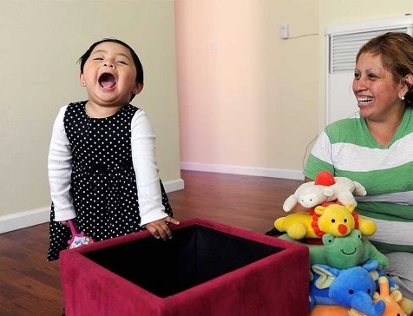
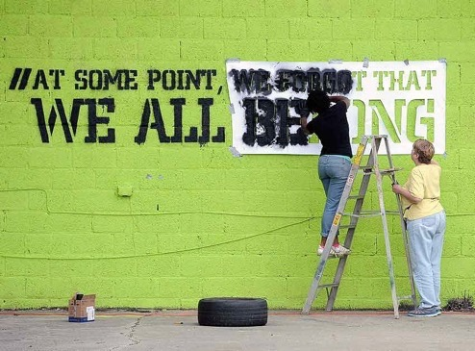
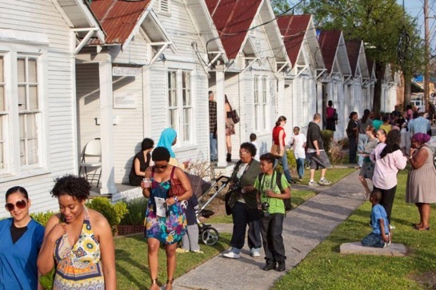
Kresge is a $3.6 billion private, national foundation that works to expand opportunities for low income people living in America’s cities
Through the work of our programs and partners, we help vulnerable people improve their life circumstances and join the economic mainstream
Notes:
For those of you who may not be familiar with Kresge, here’s a bit about the foundation.
Kresge is a national foundation located in southeast Michigan just outside of Detroit in Troy, Michigan. We also have an office in the city.
The foundation opened in 1924 with an initial gift of $1.6 million from Sebastian Spering Kresge. S.S. Kresge opened the first five-and-dime store – a revolutionary merchandising idea at the time – and parlayed the concept and operations into a chain of stores that were incorporated as the S.S. Kresge Company. Many years later, the enterprise became known as Kmart.
His mandate was to promote human progress. So for more than 80 years, the foundation realized that through the support of fundraising campaigns for brick-and-mortar capital projects – things like libraries, hospitals, schools, museums, and community centers – that, over the years, have contributed to the creation of the nation’s nonprofit infrastructure.
Beginning in the late 2000s, we shifted away from challenge grants to strategic philanthropy with a mission and defined program areas. That mission is to expand opportunities for low-income people in America's cities through an array of tools including grantmaking and social investing in arts and culture, education, environment, health, human services, and community development in Detroit.

Slide 5
Social Investing at Kresge

Slide 6
Kresge Community Finance Funding Opportunity
Kresge Community Finance aims to surface and accelerate efforts that:
Expand opportunity in America’s cities
Benefits low-income people
Is aligned with one or more of Kresge’s programmatic focus areas
Kresge plans to finance $30 million or more through
Kresge Community Finance, by March 2017

Slide 7
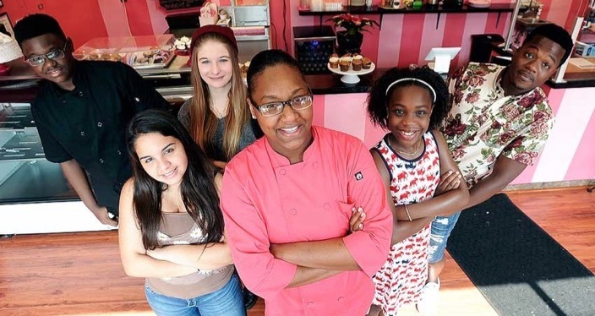
Arts & Culture Seeks to build strong, healthy cities by promoting the integration of arts and culture in community revitalization.
Notes:
The arts and culture team strives to arc into the overarching mission of the foundation: to expand opportunities for people with low-income in America’s cities by funding creative placemaking. Kresge defines creative placemaking as the integration of arts and culture into comprehensive community revitalization.
Describe Portfolios:
Our Pioneering portfolio seeks to 1) understand and operationalize the intersection of arts and culture with other fields and actors and 2) integrate the capacity for creative placemaking within or alongside local systems, e.g., public sector planning.
Our centerpiece portfolio recognizes that, while the term creative placemaking is new and the field of creative placemaking is nascent, the work itself is not. This portfolio seeks to partner with organizations that have been involved in the integration of arts and culture in community development for quite some time and are able to communicate their learning to others.
We believe that strong creative placemaking exhibits these qualities:
Connect arts and culture to larger community revitalization initiatives
Engage in cross-discipline, cross-sector activities
Possess strong leadership and vision that has an outward orientation
Advance a shared community vision
Extend benefits to all stakeholders, especially low-income people
Demonstrate explicit commitment to sustained engagement and participation of all residents
Works to ensure current residents can remain in their community even where revitalization brings new development and an infusion of newcomers
Honor community distinctiveness

Slide 8
Detroit We use a comprehensive investment strategy in our hometown to advance opportunities for people to thrive.
Notes:
Our goal in this program is to advance tangible, sustainable, near- and long-term progress in Detroit. Our investments are fully aligned with the objectives and recommendations of the Detroit Future City (DFC) Strategic Framework.
We invest through these focus areas:
GREEN, HEALTHY, ACTIVE NEIGHBORHOODS
We combine citywide investments to foster healthy neighborhoods with focused efforts in areas of the city that are positioned for stability and growth.
VIBRANT WOODWARD CORRIDOR
We pursue strategies to enhance the Woodward Corridor’s iconic identity and unique places while cultivating a fertile environment for job creation and a strong retail and commercial center.
21ST CENTURY REGIONAL TRANSIT
Since 2007, we have worked with many partners to advance the design, funding and construction of the M-1 Rail modern streetcar system on Woodward Avenue from the Detroit River to the North End neighborhood.
HIGH-QUALITY EARLY CHILDHOOD SYSTEM
We are expanding our focus on early childhood development to respond to the fact that at present less than one quarter of Detroit children are prepared for kindergarten when they start school. Through Kresge Early Years for Success, we will help create a high-capacity, well-structured set of early childhood development organizations as an important step toward the goal of fully preparing all students for kindergarten and ensuring their academic success in later grades.
ROBUST ARTS AND CULTURE ECOSYSTEM
We support a thriving arts and culture community that enriches residents’ quality of life and connections to one another. Arts and creativity enhance Detroit’s identity and its ability to attract visitors and increase economic activity. We work toward this goal through support for the Kresge Arts in Detroit Artist Fellows Program; multi-year unrestricted support of metropolitan Detroit’s arts and cultural organizations; and strategies to foster community development through arts and cultural activities.
ENHANCED CIVIC CAPACITY
We provide resources to create effective and coordinated systems of community support in partnership with government, businesses and other philanthropic and nonprofit organizations.
The Detroit program looks for projects that:
Align with the objectives and imperatives of the Detroit Future City Strategic Framework, a key reference point for people working toward broad and equitable revitalization in the city.
Connect to networks of collaborators who are focused on solving similar problems.
Complement the range of efforts by other Kresge Detroit Program grantees in specific focus areas.
Engage the community in real and meaningful ways.
Contribute over time toward lasting, sustainable solutions to Detroit’s challenges.

Slide 9
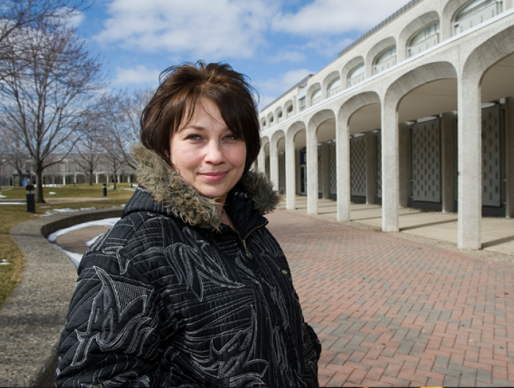
Education We promote postsecondary access and success for low-income, first-generation and underrepresented students living in cities in the United States and South Africa.
Notes:
We focus on expanding postsecondary access and success in cities for low-income, first generation and under-represented students, especially African Americans, Latinos, Asian Americans, Pacific Islanders, Native Americans and veterans living in the United States
We invest through these focus areas:
ALIGNING AND STRENGTHENING URBAN HIGHER EDUCATION ECOSYSTEMS
We use a holistic approach to strengthen local higher education ecosystems by encouraging cross-sector and networked partnerships. Partners may include: colleges and universities, nonprofit organizations, employers, K-12 school districts and government agencies, transportation systems, childcare organizations and others.
BUILDING THE CAPACITY OF INSTITUTIONS FOCUSED ON LOW-INCOME AND UNDERREPRESENTED STUDENTS
We seek to build the capacity of community colleges, public regional institutions and minority-serving and Title III and Title V schools.
STRENGTHENING PATHWAYS TO AND THROUGH COLLEGE
Our primary goal in improving postsecondary access and success is to get more students – especially low-income, first generation, and underrepresented students – into two- and four-year colleges and universities and increase the number who graduate and find jobs.
We fund both on-campus innovations and off-campus determinants of student success. We look for opportunities that help low-income students better navigate the college-entry process and overcome barriers, so that they are able to stay in school and earn their desired degree or credential.
We invite projects that represent one or more of the following:
Partnerships or networks of institutions (not individual institutions).
Have potential for long-term sustainability.
Have potential for broad scalability or replicability.
Offer opportunities to reinforce change within our geographic focus states (Arkansas, California, Florida, Michigan, and Texas) or in cities with emerging coalitions to promote student success.
Technological or practice enhancements that decrease costs for and improve effectiveness of institutions seeking to improve student success.
Work that has the potential to lead to systemic changes.

Slide 10
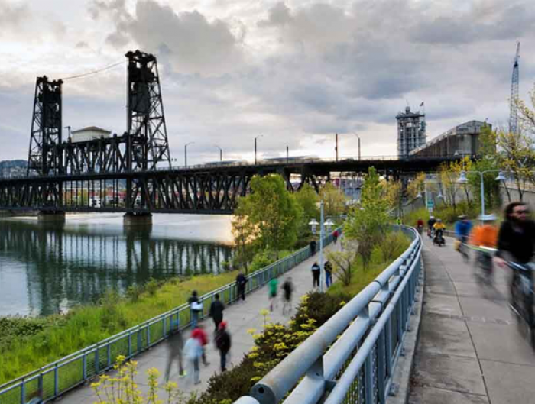
Environment We help communities build resilience in the face of climate change.
Notes:
Our work is intended to help civic leaders consider a two-part climate question as they make decisions that shape the form and function of their communities:
Does a proposed policy or action have implications – positive or negative – for the severity of climate change? If negative, how will they be addressed?
Do the expected consequences of climate change affect the viability of a proposed policy or course of action? If so, what should be done differently?
We invest through these focus areas:
CLIMATE RESILIENCE AND URBAN OPPORTUNITY
We work to strengthen the capacity of community-based nonprofit organizations to influence local and regional climate-resilience planning, policy development and implementation to better reflect the priorities and needs of low-income people in cities in the United States.
CLIMATE RESILIENCE IN COASTAL CITIES AND REGIONS
We work to advance comprehensive climate resilience initiatives in coastal cities and regions within the U.S. such that cities and their residents are preparing for the consequences of sea-level rise and other climate impacts while working toward a low-carbon energy future.
SUSTAINABLE WATER RESOURCES MANAGEMENT IN A CHANGING CLIMATE
We work to advance climate-smart, sustainable water resources management policies and practices in cities and regions across the U.S. that enable cities to meet water demand, protect residents and surrounding natural areas from the adverse impacts of climate change and embed this work within their larger climate resilience agendas.
URBAN ENERGY RESILIENCE
We work to help cities develop and implement long-term plans for achieving dramatic reductions in greenhouse gas emissions, embed this work within their larger climate resilience agendas, and ensure that low-income community members are engaged in shaping the urban energy-system transformation.
We look for projects that:
Enable people and institutions to work together to address the climate crisis, with an eye toward innovation, problem-solving and informed risk taking.
Have a tangible impact on policy and practice.
Cut across sectors and disciplines.
Promote integrated, system-based initiatives.
Engage and empower historically underserved people and communities.
Focus on outcomes that will be achieved.
Closely align with our strategies and hold strong promise to bring about positive change.
Work nationally, across multiple states or at the regional or statewide level.
Are based within the United States.

Slide 11
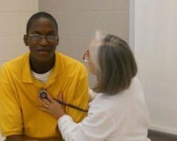
Health Aims to promote health equity by addressing conditions that lead to poor health outcomes.
Notes:
The Kresge Health team works in two program areas: Developing Healthy Places, where you will find our work in food systems, housing, land use and transportation; and Accelerating Community-Centered Approaches to Health, where we support collaborations between health systems, public health and a range of community based organizations that share resources and responsibility for improving population health and promoting health equity.
The Kresge Health team has been funding food systems work since 2008. We started our work primarily by focusing on expanding access and affordability of healthy food in low income communities. Since then, we have broadened our perspective to include other components of the food system, particularly aggregation, processing and distribution. We have grown to appreciate the role that food-oriented development can play in expanding economic opportunities in low income urban neighborhoods. This partnership with Kresge’s Arts & Culture team takes our evolution one step further, by incorporating cultural expression and creative placemaking.
We look for proposals that:
Include genuine community engagement and leadership.
Facilitate cross-sector partnerships and connections.
Link practitioners to objective evidence and science.
Promote community or population health.
Direct resources to upstream solutions.
Promote access to opportunities that can improve health.
Employ effective communication strategies.
Evaluate and disseminate the impact of health initiatives, programs and investments.

Slide 12
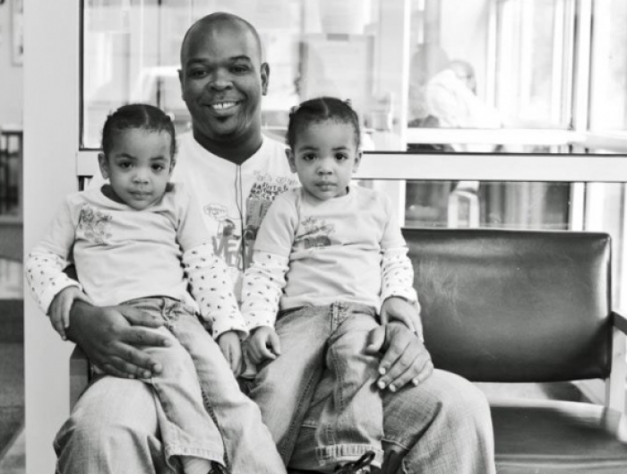
Human Services We strengthen human services organizations that improve the quality of life and economic security of low-income and vulnerable people.
Notes:
In March 2016, the board approved a refresh of our Human Services strategy. At the time of launch of our RFP, we did not have updated language reflecting that tweak to the strategy. We are open to submissions for work under our focus areas as of March 30.
The overview for our Human Services team is to help people living in poverty to have the essential supports required to achieve well-being and lead self-sufficient, self-determined, productive lives. These supports include safe and healthy housing and neighborhoods, fresh foods and high-performing schools. Human services organizations play a key role by providing access to these services and many more.
We invest through these focus areas:
ADVANCING THE EFFECTIVENESS AND RESILIENCE OF HUMAN SERVING ORGANIZATIONS
(New language: Advancing innovative, multi-sectoral policy solutions in Human Services)
We look for opportunities to partner with high-performing organizations that seek to increase their ability to innovate and take their service-delivery and systems-change work to a higher level.
LEVERAGING THE EFFECTIVENESS OF NETWORKS
(New language: Fostering the next generation of Human Services organizations)
We support national, regional and local networks that increase effectiveness and ultimately improve the quality of life and economic security of low-income individuals and families.

Slide 13
Application Eligibility

Slide 14
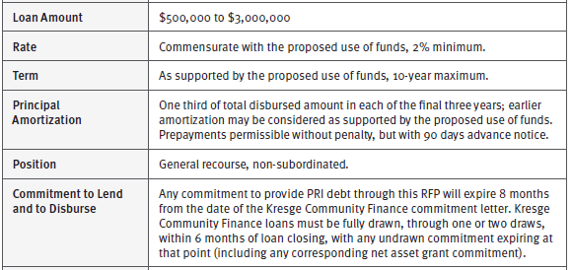
Key Terms

Slide 15
Key Dates & Proposal Requirements
Letter-of-Inquiry (1st stage in a 2-stage process)
Due before: 5pm Pacific on April 29th
Late submissions will not be accepted
Before the end of May, selected applicants will be invited to submit a Full Proposal (2nd stage)
Financing commitments will be announced by the
end of July, subject to underwriting.

Slide 16
Mechanics of Application Process
To complete the letter-of-inquiry, you will need to log-in to our online application portal.
The portal is configured to work optimally in Google Chrome
The portal can be accessed here: https://kresge.fluxx.io.
First-time visitors will be required to create a new account by clicking on “create an account now.”
Register early to account for turnaround time needed to set up (typically 48-72 hours)
→ GO TO WEBSITE: https://kresge.fluxx.io
→ NEED HELP: grantsmanagement@kresge.org
Notes:
In order to apply for funding from Kresge Community Finance you have to submit your application material through Kresge’s grants mgmt system called Fluxx. It takes a few days to set up your profile in FLUXX. YOU WILL HAVE TO REGISTER IN FLUXX WELL BEFORE THE DEADLINE.
So this means, if you are even remotely thinking about applying……register now. It does take a couple of days to wait for the registration to confirm.

Slide 17
Top Frequently Asked Questions & Answers
Q: What do you mean by “quasi-public” or private DFAs?
A: Development finance agencies that are not subject to direct government control, so for example, if a board is appointed by elected officials, but staff is otherwise independent, and not all board members turn over after each election, that organization likely would qualify.
Q: What is Kresge looking to finance?
A: Projects that expand opportunity in America’s cities, particularly for low-income people and particularly for projects that are aligned with one or more of Kresge’s focus areas as further detailed and described at Kresge.org.
Q: Can organizations apply as a group?
A: Collaborations are welcome, but each Kresge loan agreement can have only one borrower / counterparty, so lead applicants would serve as an intermediary in any collaboration or partnership.
Notes:
We’ve gotten many questions so far, here’s a snapshot of some frequently asked questions:
Only US and US territory based organizations can apply.
What types of organizations can apply? To be frank, we are somewhat agnostic about exact type of eligible applicant; what we are clear on is that there be an authentic and high quality relationship with the neighborhood, not just a symbolic partnership. The most compelling lead organizations are those that are EMBEDDED AND TRUSTED by their neighborhood residents. Strong engagement and leadership by community members will be key. We are anchored in understanding your community and how your project will interact with the community.
Offering guidance on the length of your proposal to under 10 pages, though the Fluxx system has no word limit
Lastly we talked about integrating across different disciplines. Well if you are not already there yet, don’t worry. That’s what this initiative can help you do. Maybe you have a vision aligned with FreshLo but you don’t have the right partners, well the planning period can be used to develop partnerships, build out a plan and work on growing into new areas and new relationships. You don’t have to be nearly ready to implement, you can put forth a compelling proposal by showing us how you would grow.

Slide 18
Thank you!
Thank you for your time, interest and participation!
Webinar recording will be available
And now for your questions……
Notes:
Before we jump into the Q&A, we want to take a moment to thank you for your time and participation and also let you know this webinar was recorded and will be publicly accessible. We will email all registered attendees with details on viewing the recording. Now onto your questions!
WE’RE NOT LOOKING TO ANSWER QUESTIONS SPECIFIC TO YOUR PROJECT BUT RATHER BROADLY.

Slide 19
Additional Questions…
What questions do you have?
Submit now
using the Questions window
After the webinar
questions can be emailed to:
socialinvestments@kresge.org
@kresgefdn
@kresgesocinv
Notes:
STACEY
FACILITATE Q&A
CLOSING:
Whether you decide to apply or not, by joining us today we know you are engaged in the national conversation about food, community, culture and health. We hope this is the first of many conversations we have with you. Thank you for joining today’s webinar, we look forward to seeing your application and amplifying how food can revitalize neighborhoods together. Thank you and have a great day.
END.

