Slide 1
Overview of Venture Capital Programs with State Small Business Credit Initiative Funding
Education · Advocacy · Research · Resources · Networking
September 22, 2021

Slide 2
Speakers
Nicole Washington
Boralogix
Angel Capital Association
Clay Rankin
North Coast Ventures
Angel Capital Association
Maryam Haque
Venture Forward
Justin Field
National Venture Capital Association

Slide 3
Speakers
Karl Fooks
U.S. Department of the Treasury
Katie Kramer
Council of Development Finance Agencies
Rachel Reilly
Aces & Archers
Council of Development Finance Agencies

Slide 4
Agenda
What is equity capital?
Why is equity capital investment important?
How is equity capital invested?
Angel Investment
Venture Capital Investment
SSBCI 1.0 experience with equity programs.

Slide 5
What is equity capital investment? Common structure, unique results
Equity investment into company, new ideas
That couldn’t be financed with traditional bank financing
With high-growth trajectory that threaten to established products/services or creates new sectors
That take 8-10+ years to reach maturity
There is little/no actual company value unless it’s acquired or goes public

Slide 6
What is equity capital investment? Common structure, unique results
Economic alignment among all stakeholders
Value/success is not driven by quick returns, financial engineering, debt, or transaction fees
Founder benefit – appreciated stock/stock options
Employee benefit – stock options
VC investor & LPs split the gains
LP benefit to their constituents (endowments, foundations, pensions)
Failure is inherent: most equity-backed startups fail!
Strong ecosystems help startups survive
Industry standard investment practices generate success

Slide 7
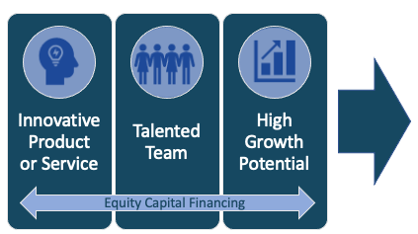
Equity capital-backed startups drive net job creation
Startups in operation for 1-5
years and those growing to have
20+ employees play a large role
in community net job creation; employment concentrated in businesses with high levels of
STEM employees.
Source: Congressional Research Service, 2021
Cannot be financed with traditional bank financing.
Typically require 5 - 8 years (or longer!) to reach maturity.

Slide 8
Equity capital + founder build companies from scratch

Slide 9
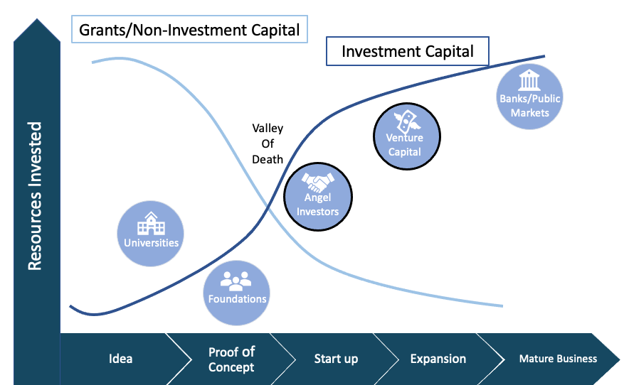
Capital continuum
Equity capital is a continuum of investment that turns an idea into a startup and grows it into a company.

Slide 10
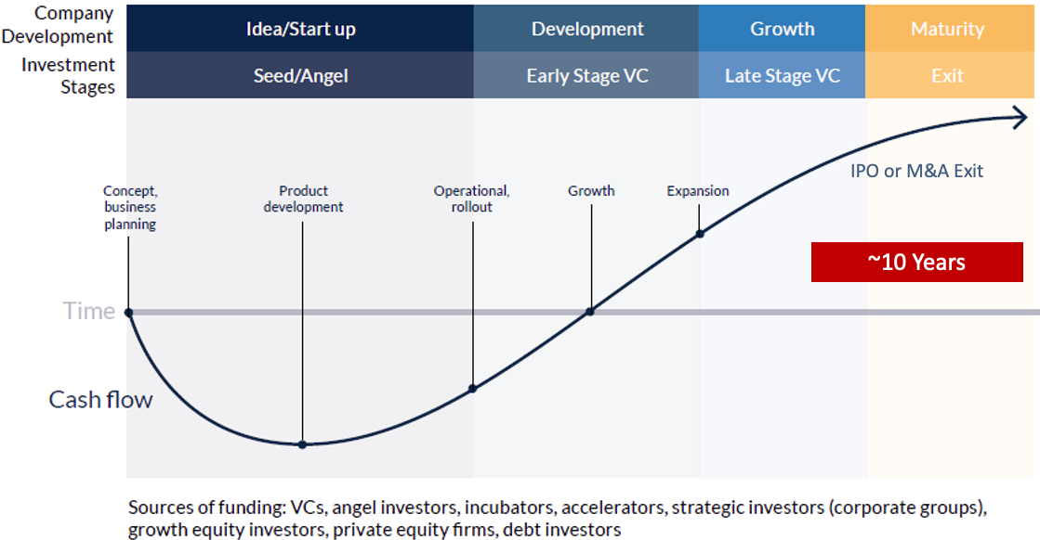
Equity capital investment path is long
4

Slide 11
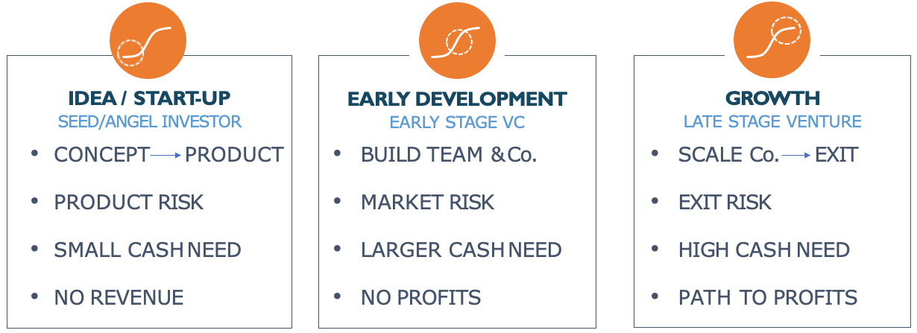
Equity capital’s vital role in startup growth More than money
4

Slide 12
Type of startup suitable for equity capital investment
INNOVATIVE
Product or service with potential to disrupt a market
TALENT
Management team able to execute the business model
Cannot be financed with traditional bank financing.
Typically require 5 - 8 years (or longer!) to reach maturity.
HIGH GROWTH
Able to reach/capture a large market segment
4

Slide 13
Speakers
Nicole Washington
Boralogix
Angel Capital Association
Clay Rankin
North Coast Ventures
Angel Capital Association

Slide 14
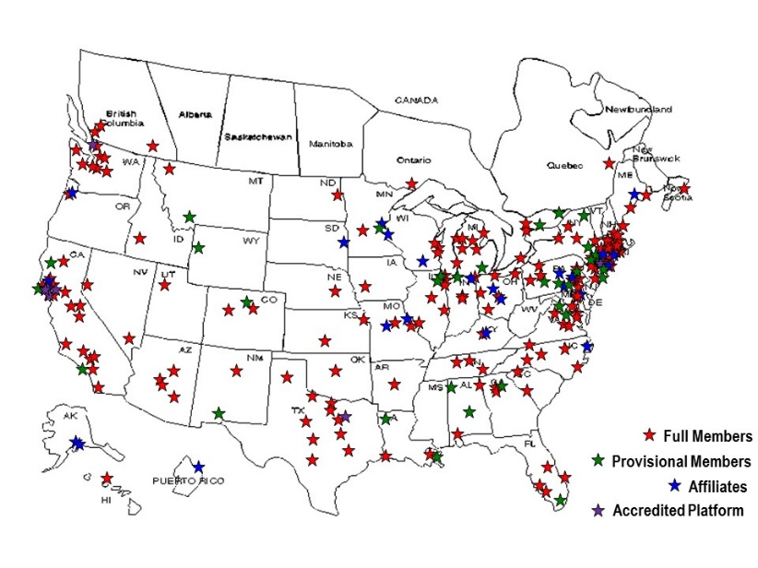
Angel Capital Association
World’s largest association of accredited angel investors
14,000 investors
270+ Angel groups
Accredited platforms
Family offices
Individual angels
Every U.S. state & 5 Canadian provinces
Mission: Fuel success of angel groups and accredited investors, as well as the early-stage companies they support
www.angelcapitalassociation.org

Slide 15
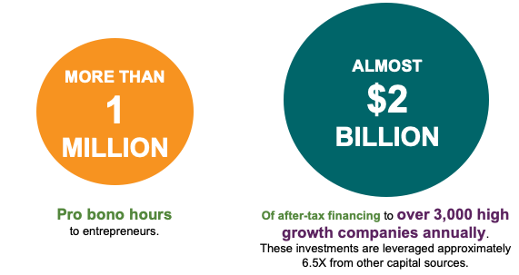
The Impact of ACA Angels
Entrepreneurs can find funding from many sources, but money alone cannot create success. Angels are unique, wrapping needed funding around crucial seasoned mentorship and industry connection. This proven formula drives true growth and success.
ACA is the largest supporter of investment (of both start-up capital and pro bono expertise) in entrepreneurship. Annually, ACA’s 14,000 members provide:

Slide 16
Angels fund the majority of startups in the USA

Slide 17
What is an Angel Investor?
Angel investors are high net worth individuals who invest their own money into seed stage startup companies, providing much-needed capital to bring new companies to market.
Angels can be anyone in the US that meet the following criteria:
Annual income of $200,000 ($300,000 if married) or $1m in net worth minus your home. (New Sophistication rules pending)
Angels also give of their time (1,000,000 volunteer hours every year to start ups).
Angels care about Entrepreneurs and their local community.
“Entrepreneurs are the engine for economic growth and Angels are the fuel for that engine.”

Slide 18
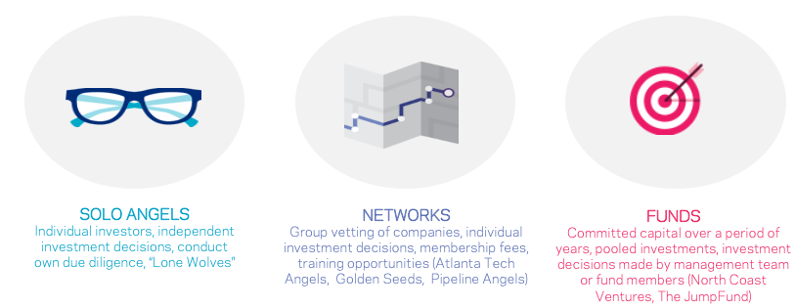
Types of Angel Investors

Slide 19
Why do people become Angel Investors?
Help build innovation in their local community.
Help job creation.
Utilize skills and expertise developed over a lifetime.
Generate financial returns.

Slide 20
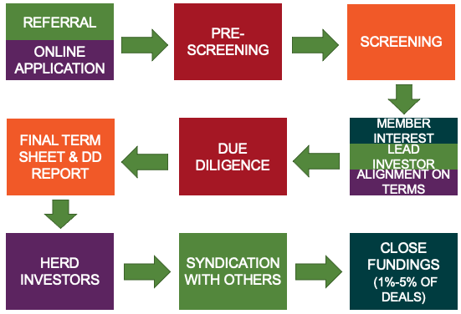
Angel Group deal flow process

Slide 21
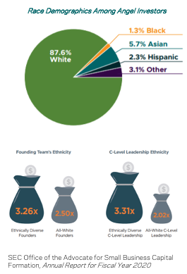
Diversity, Equity and Inclusion progress
We celebrate progress.
At the same time, we see ongoing inequities and a trove of missed opportunities.
ACA has shown its ability to advance women in Angel investing and entrepreneurship - Women Angels grew from just 5% to 27% in the past decade
Started programs with investors and entrepreneurs in other underrepresented groups in an equally focused manner.
We see the opportunity to increase prosperity while narrowing persistent wealth gaps.

Slide 22
Speakers
Maryam Haque
Venture Forward
Justin Field
National Venture Capital Association

Slide 23
About NVCA & Venture Forward
Empowers the next generation of American companies that will fuel the economy of tomorrow
As the voice of the U.S. VC and startup community, NVCA:
Advocates for pro-startup public policy
Is the leading resource for venture capital data
Convenes participants in the startup ecosystem to generate peer-led initiatives, facilitate networking, and provide practical education
About the NVCA SSBCI Working Group:
Working group of ~50 NVCA member funds who provide expertise and analysis regarding SSBCI implementation
Workflows include providing comments on the Treasury policy guidelines and crafting a best practices document for state economic development officials regarding industry standards and other recommendations for equity programs

Slide 24
About NVCA & Venture Forward
Drives the human capital, culture, values, and narrative of venture capital to promote a strong and inclusive community that will fuel the economy of tomorrow
501(c)(3) supporting organization to NVCA
Focus on:
Diversity, equity & inclusion (LP Office Hours)
Education (VC University)
Research (VC Human Capital Survey)
Industry history (Partnership with Computer History Museum)
Impact stats:
- Educated 1,400 new, aspiring & early-career VCs
- Collected & reported DEI data from 375+ VC firms

Slide 25
Equity capital for high-growth businesses
Founder + VC = Growth

Slide 26
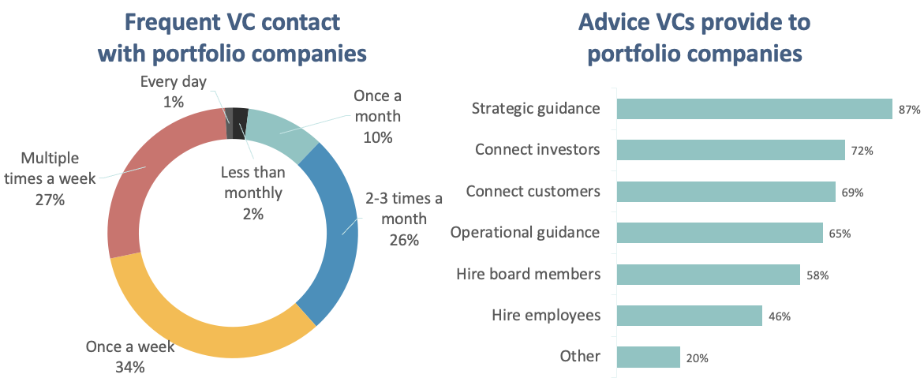
Venture capital investors partner with entrepreneurs
Source: Gompers, Paul A. and Gornall, Will and Kaplan, Steven N. and Strebulaev, Ilya A., How Do Venture Capitalists Make Decisions? (August 1, 2016).

Slide 27
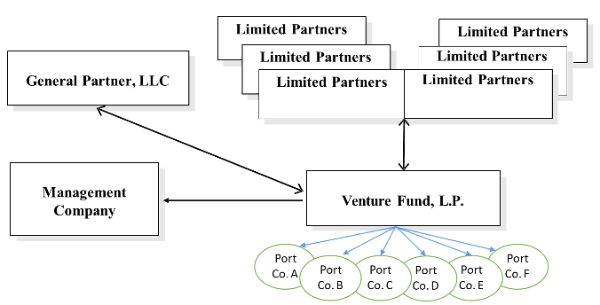
Venture capital fund structure

Slide 28
Venture capital cycle

Slide 29
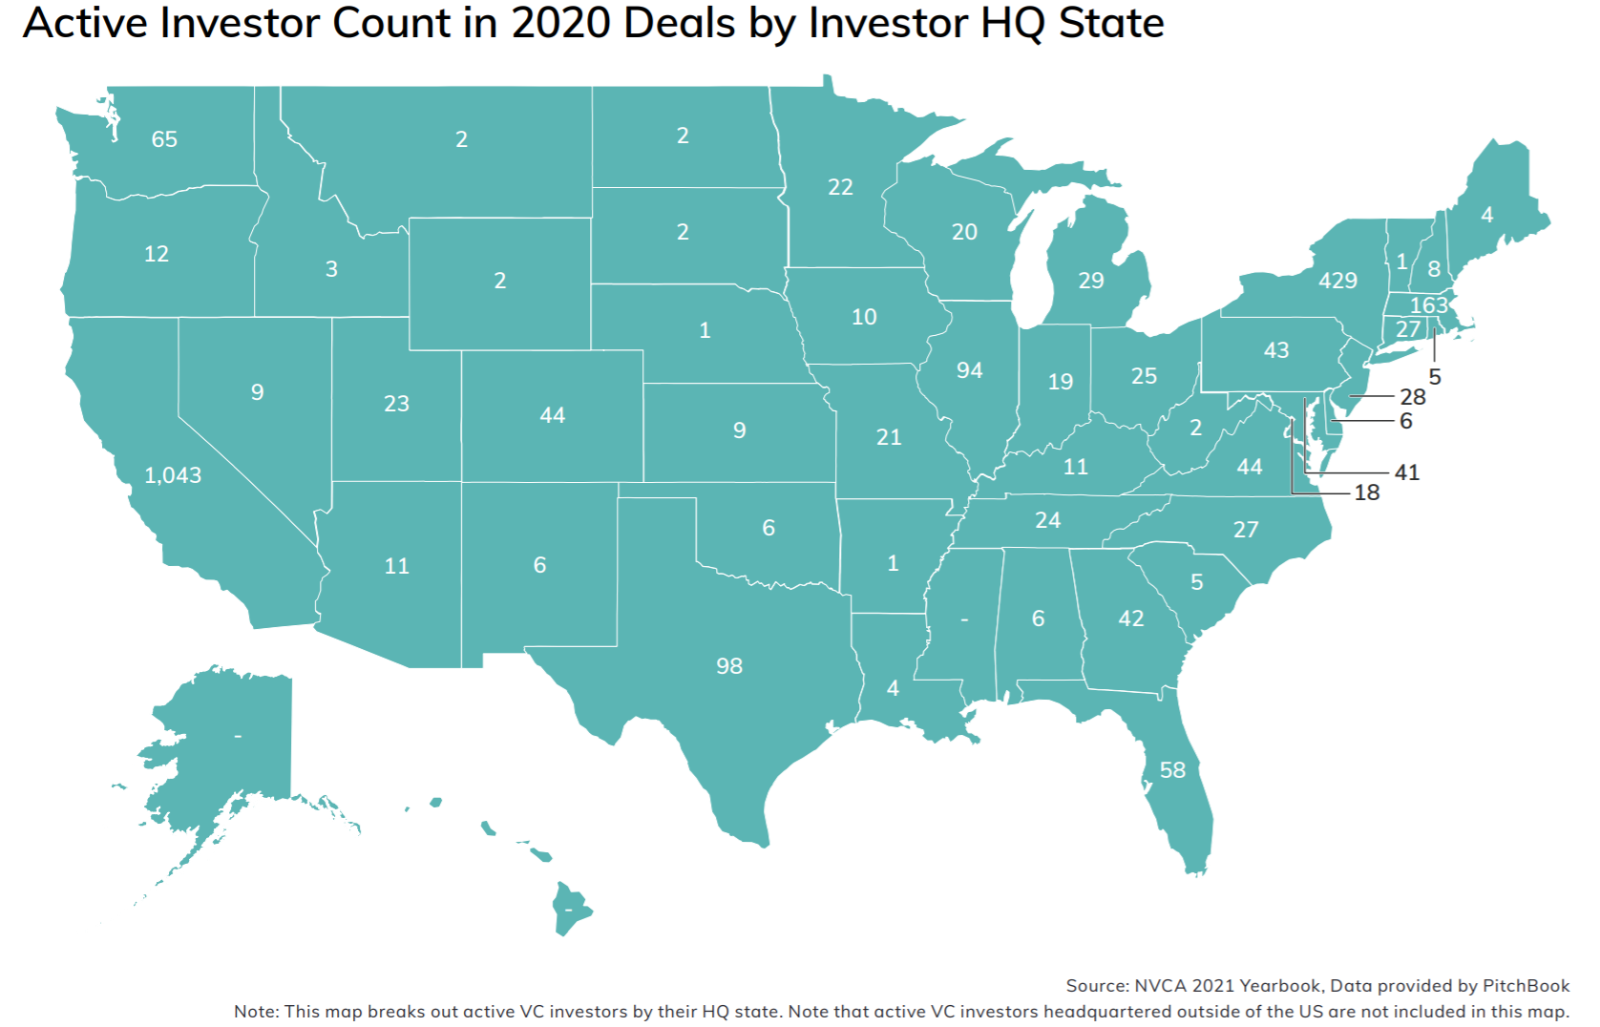
Venture capital investors at a glance
At end of 2020:
2,500 active US VC investment firms
Managing $550B in assets & 2,000 funds
About 2/3 of firms manage <$100M
$25M = Median fund size out CA, MA & NY (vs. $100M in CA, MA & NY)

Slide 30
VC-backed companies Innovation and impact
Sources: NVCA 2021 Yearbook; Gornall, Will and Strebulaev, Ilya A., The Economic Impact of Venture Capital: Evidence from Public Companies (June 2021). Available at SSRN: https://ssrn.com/abstract=2681841

Slide 31
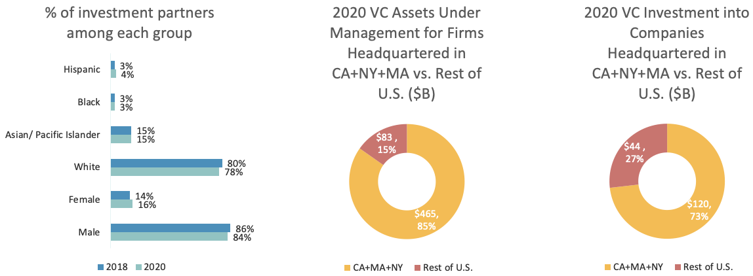
Diversity, Equity, and Inclusion Challenges and opportunities

Slide 32
Speakers
Karl Fooks
U.S. Department of the Treasury

Slide 33
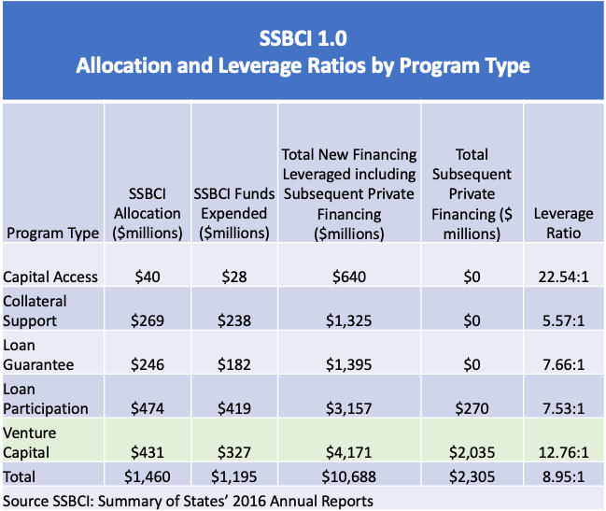
Equity capital programs in SSBCI 1.0
35 States implemented an equity capital program
24 implemented Direct Investment Programs
8 implemented Fund Investment Programs
3 implemented both
$431mm or 30% of total SSBCI Allocation was for equity capital programs
Equity Capital Programs were able to exceed the 10:1 Leverage Ratio goal.

Slide 34
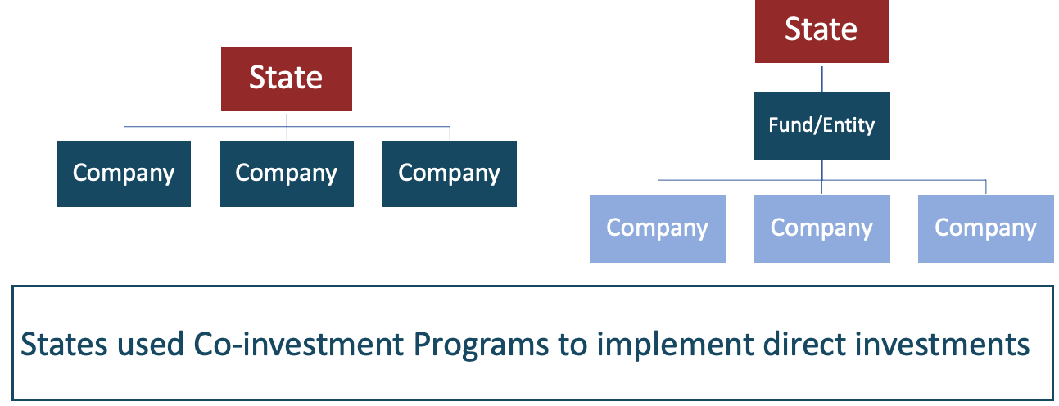
State Venture Capital Direct company investment

Slide 35
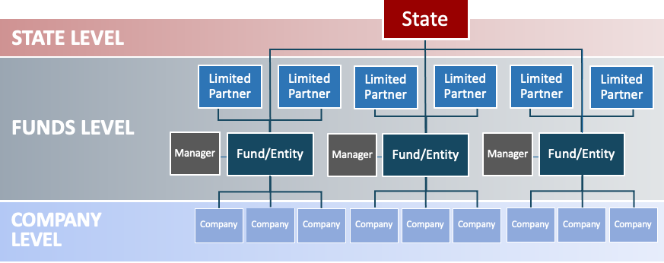
State Venture Capital Fund Investment

Slide 36
State program design considerations
Equity Capital Programs are effective when they address gaps in the financing continuum
Understand your startup ecosystem
Entrepreneurs
Startup Events/Pitch Competitions
Venture Development Organizations
University commercialization programs
Angel Investor networks
Venture Capital Funds
Service providers, including media partners
Ability to reach Socially and Economically Disadvantaged Individuals

Slide 37
State program capacity considerations
State/program regulatory constraints – able to invest?
Expertise – ability to recruit/retain team?
Procurement process – RFP?
Decision making process – Fast?
Monitoring and reporting process

Slide 38
Q & A
Nicole Washington
Boralogix
Angel Capital Association
Clay Rankin
North Coast Ventures
Angel Capital Association
Maryam Haque
Venture Forward
Justin Field
National Venture Capital Association
Karl Fooks
U.S. Department of the Treasury

Slide 39
Join CDFA Today!
Advancing Development Finance Knowledge,
Networks & Innovation.
Discounted Registration Rates for CDFA Trainings & National Summit.
Reduced Rates for Publications in the CDFA Bookstore & Special Offers from Industry Partners.
Exclusive Access to the CDFA Online Resource Database and Federal Financing Clearinghouse.
Free Job and RFP Postings.
www.cdfa.net
@CDFA_update
Notes:
Rachel and Katie

